Slide 1
Trees
Presentation for use with the textbook Data Structures and Algorithms in Java, 6th edition, by M. T. Goodrich, R. Tamassia, and M. H. Goldwasser, Wiley, 2014
Mammal
Dog
Pig
Cat

Slide 2
General Trees
8.1

Slide 3
What is a Tree 1
In computer science, a tree is an abstract model of a hierarchical structure
A tree consists of nodes with a parent-child relation
Every node except the top one has a parent
Every node has zero or more children elements
Computers”R”Us
Sales
Manufacturing
R&D
US
International
Laptops
Desktops
Europe
Asia
Canada

Slide 4
What is a Tree 2
Applications:
Organization charts
File systems
Programming environments
Websites
Databases
Computers”R”Us
Sales
Manufacturing
R&D
US
International
Laptops
Desktops
Europe
Asia
Canada

Slide 5
Family Tree shows Hierarchy
Fig. 8.1, p. 308

Slide 6
Tree Terminology 1
Root: node without parent (A)
Internal node: node with at least one child (A, B, C, F)
External node (a.k.a. leaf ): node without children
(E, I, J, K, G, H, D)
A
B
C
D
E
F
G
H
I
J
K

Slide 7
Tree Terminology 2
Ancestors of a node: parent, grandparent, great-grandparent, etc.
Descendant of a node: child, grandchild, great-grandchild, etc.
A
descendants
B
C
D
E
F
G
H
I
J
K
ancestors

Slide 8
Tree Terminology 3
Depth of a node: number of ancestors
Height of a tree: maximum depth of any node (3)
d=0
A
d=1
B
C
D
d=2
E
F
G
H
h=3
d=3
I
J
K

Slide 9
Tree Terminology 4
Subtree: tree consisting of a node and its descendants
A
subtree
B
C
D
E
F
G
H
I
J
K

Slide 10
Formal Tree Definition
Formally, we define a tree T as a set of nodes storing elements such that the nodes have a parent-child relationship that satisfies the following properties:
If T is nonempty, it has a special node, called the root of T, that has no parent.
Each node v of T different from the root has a unique parent node w; every node with parent w is a child of w.

Slide 11
Formal Tree Definition
Note that the tree can be empty
The tree can be defined recursively, either
The tree is empty, or
Non-empty:
The tree has a root, r
The root has a set of subtrees, possibly empty: the children of r

Slide 12
Other Node Relationships
Two children of the same node are siblings
A
B
C
D
E
F
G
H
I
J
K

Slide 13
Other Node Relationships
A node v is external if it has no children
A
B
C
D
E
F
G
H
I
J
K

Slide 14
Other Node Relationships
A node v is internal if it has one or more children
A
B
C
D
E
F
G
H
I
J
K

Slide 15
Ancestor
A node u is an ancestor of a node v if
u =v, or
u is an ancestor of the parent of v
A
A is an ancestor of B and F
B
E
F

Slide 16
Descendant
A node v is an descendant of a node u if u is an ancestor of v
A
F is a descendant of A, B
B
E
F

Slide 17
Subtree
The subtree of T rooted at a node v is the tree consisting of all the descendants of v in T (including v itself).
B
E
F

Slide 18
The subtree rooted at cs016/ consists of the nodes cs016/, grades, homeworks/, programs/, hwl, hw2, hw3, prl, pr2, and pr3.

Slide 19
Edges and Paths in Trees
An edge of tree T is a pair of nodes (u,v) such that
u is the parent of v, or
v is the parent of u
A
B

Slide 20
Edges and Paths in Trees
A path of T is a sequence of nodes such that any two consecutive nodes in the sequence form an edge.
A
B
E

Slide 21
This figure contains the path cs252/, projects/, demos/, market

Slide 22
Ordered Tree
A tree is ordered if there is a meaningful linear order among the children of each node

Slide 23
The Tree ADT
8.1.2

Slide 24
Tree Abstract Data Type
We use positions to abstract nodes
Accessor methods:
Position root()
Position parent(p)
Iterable children(p)
int numChildren(p)

Slide 25
Tree ADT
Query methods:
boolean isInternal(p)
boolean isExternal(p)
boolean isRoot(p)
Additional update methods may be defined by data structures implementing the Tree ADT

Slide 26
Tree Abstract Data Type
Generic methods:
int size()
boolean isEmpty()
Iterator iterator()
Iterable positions()

Slide 27
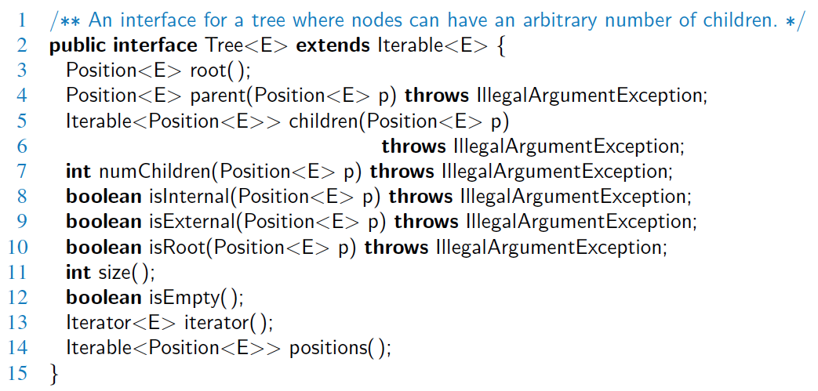
Java Interface
Methods for a Tree interface:

Slide 28
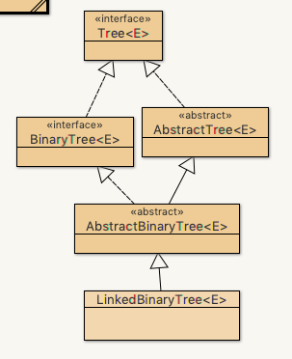
Tree Interface
Open up DSAJ-sourcecode with BlueJ
find package net.datastructures
open
file Tree.java
Notes:
Contains only the interface, no code

Slide 29
Computing Depth and Height
8.1.3

Slide 30
Computing Depth
For a certain node, what is its depth in the tree?
Depth defined recursively, until root is found

Slide 31
Computing Height
Height of a tree defined as maximum depth of a node.
Loop through all nodes (BAD, quadratic method below)

Slide 32
Computing Height (bad version)
Loop through nodes?
A
B
C
D
E
F
G
H
I
J
K

Slide 33
Computing Height
Better recursion from root
Leaf node is base case
Each node called only once

Slide 34
Computing Height (better)
Recursive starting with root
A
B
C
D
E
F
G
H
I
J
K

Slide 35
AbstractTree Abstract Class
Open up DSAJ-sourcecode with BlueJ
find package net.datastructures
open
file AbstractTree.java
Locate the methods
depth()
heightBad()
height()
Notes:
Why locate these methods in an abstract class?

